Slide 1
Reliant Edge Solutions Health Homes
The Importance of a Primary Care Physician

Slide 2
What is a Health Home and why do I need one?

Slide 3
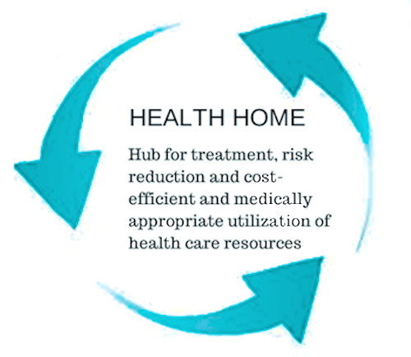
Health Home
A Health Home is a continuous partnership between the Primary Care Physician’s practice and the patient. The intent is to keep the patient as healthy as possible by proactively addressing potential problems, managing known conditions and appropriately dealing with situations as they arise.

Slide 4
Health Home
Primary Care Physicians and a continuity of care. Continuity of care means that you establish a relationship with a health care provider and you enhance that relationship year after year.
Annual comprehensive exam
Personalized care plans
Care guidelines as regards chronic conditions

Slide 5
Why should I have a Health Home?
Health Homes provide consistent and often times quicker care services for future care needs due to the constant addition to your health history and the ease of access to prior illness and treatments that you have already received.
Having a Health Home should reduce the following all which provide better patient care while reducing out of pocket expenses;
Emergency department visits
Medications
Redundant diagnostic tests
Use of high-tech radiology
Visits to specialists

Slide 6
Where does a specialist fit into the Health Home concept?
Having a Health Home enhances the use of specialists based on the collaborative relationship already in place with the PCP.
This allows for one point of contact and a prioritization of care based on your specific medical situation.
In this fashion your PCP and the specialist increase the likelihood of diagnosing and treating the real issue faster and more efficiently.
Together they provide increased care quality at a lower cost to you by avoiding unnecessary testing and exams caused by many self-referrals.

Slide 7
Health Home
Through the relationship created with you and a Health Home a more open and honest dialogue of care is in place allowing you to feel more comfortable with and be an active participant in the type of care received!

Slide 8
Health Home

